Slide 1
Climatic Trend Impact on Alaskan Stream Discharge
Gaby Garcia, Walker Grimshaw, Tristen Townsend, Yixin Wen

Slide 2
Background & Rationale
Polar amplification: climate change is having larger impacts near the poles¹
Changes in volume & timing of discharge have serious implications for water users & managers^{2, 3}
Increased temperatures can lead to permafrost & glacial melting: ice-albedo feedback can perturb global climate systems⁴

Slide 3
Research Question
To what degree does climate change affect discharge in Alaskan streams?
Hypotheses:
Streams at varying latitudes will have different responses to changing climate with a monotonic trend related to latitude.
If streams are in areas that experience greater mean air temperature increases, then they will have greater discharge.
If temperature increases over time, the day of year of first snowmelt will occur earlier.

Slide 4
Dataset Information
Site & stream Discharge data from NWIS
Temperature & precipitation data from NOAA

Slide 5
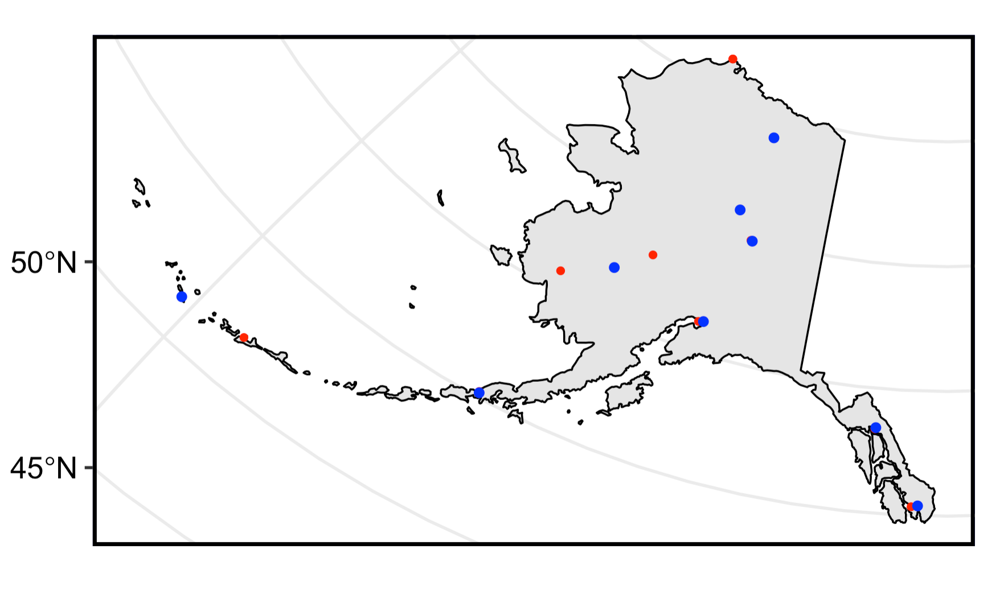
Study Locations
8 equal latitude bins, 1 larger bin for northern-most sites
1 discharge and 1 climate site per bin
NOAA Sites-Precipitation and Temperature
NWIS Sites-Discharge

Slide 6
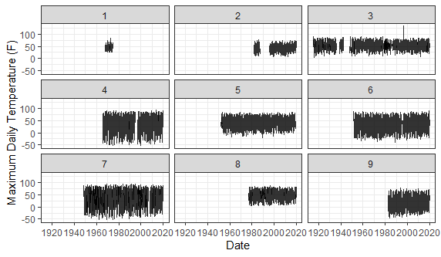
Exploratory Analysis: Temperature

Slide 7
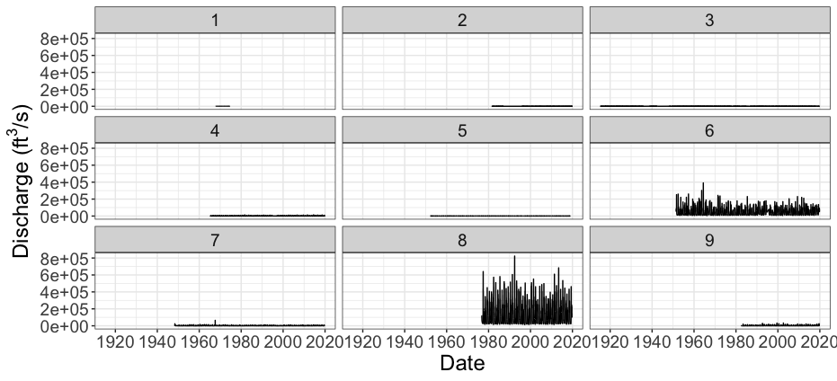
Exploratory Analysis: Discharge
Notes:
Discharge changing over time in Alaska in 9 bins, discharge data of bin 1 is very limited to do any useful analysis. Bin 6 and 8 are larger rivers and have very obvious seasonal change directly from this graph. Other bins for now are hard to tell if there are seasonal changes or not

Slide 8
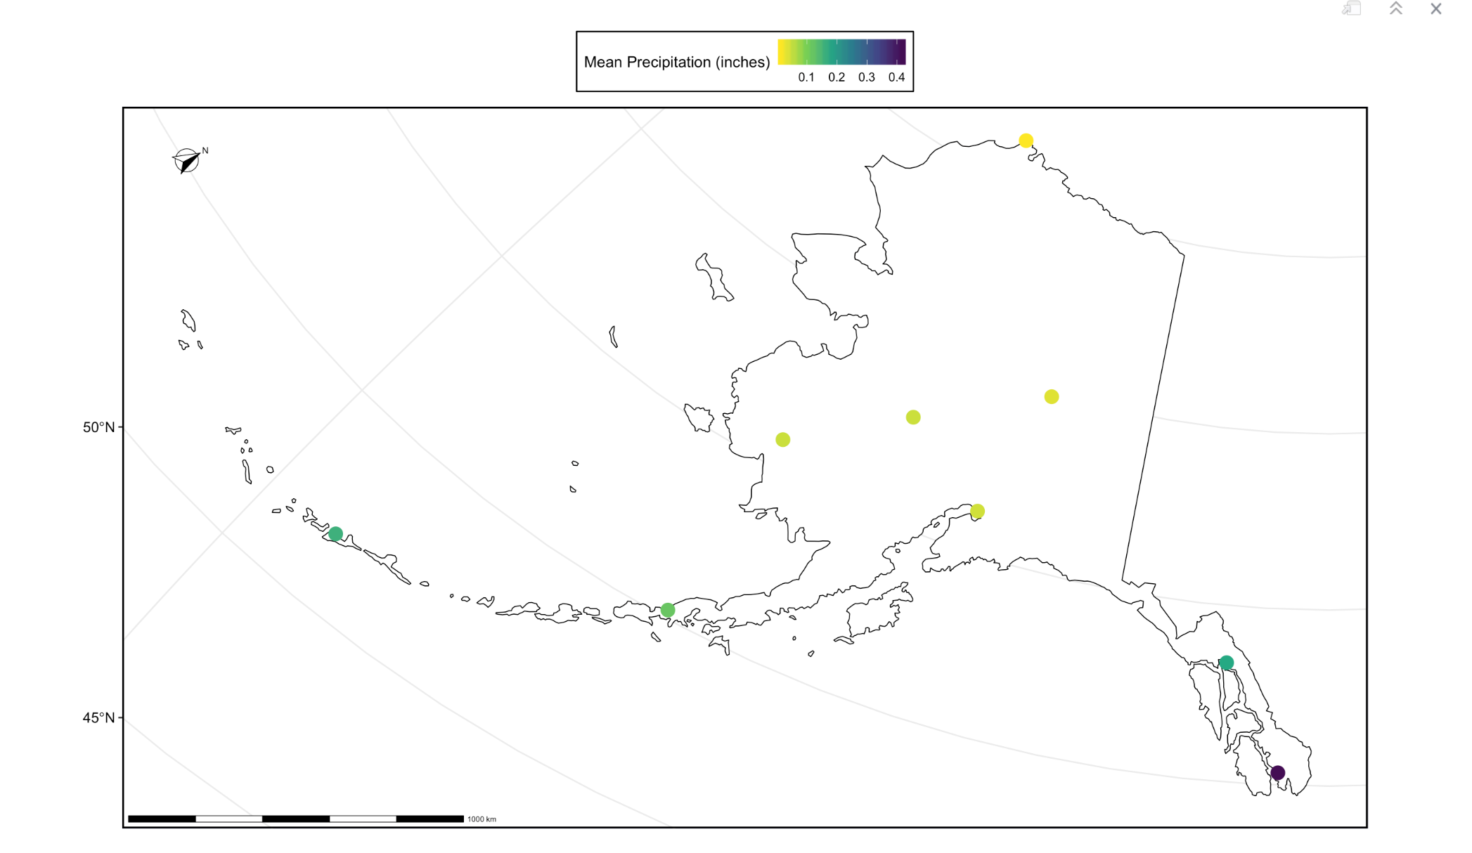
Exploratory Analysis: Precipitation

Slide 9
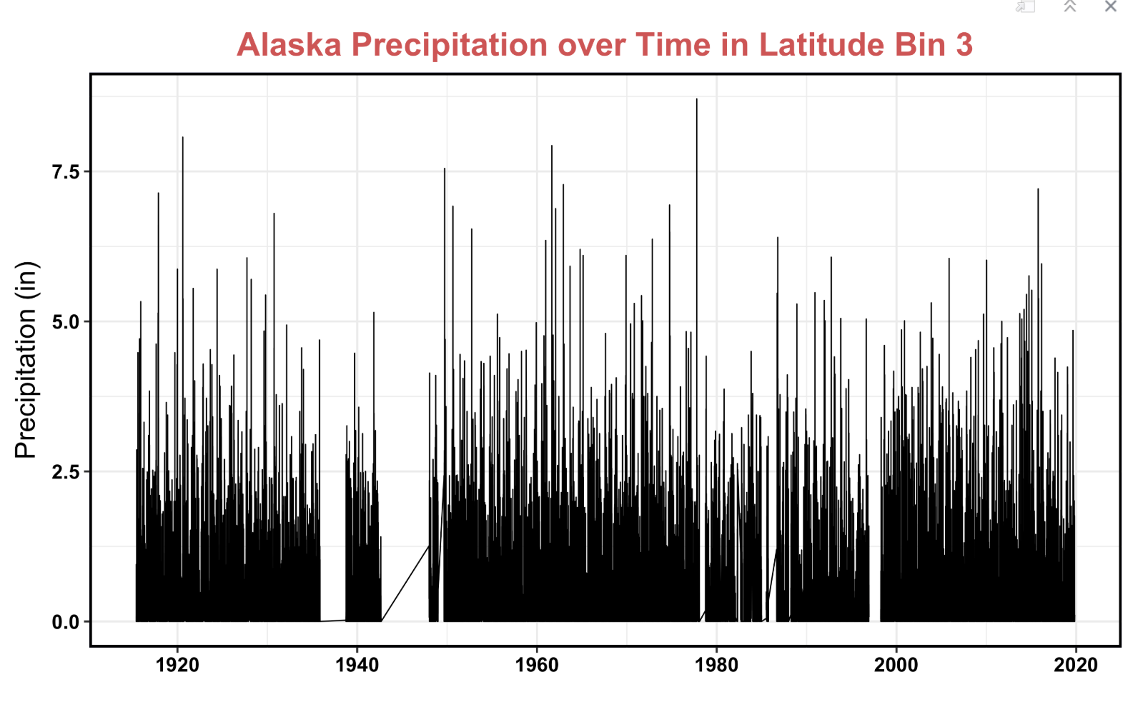
Exploratory Analysis: Precipitation

Slide 10
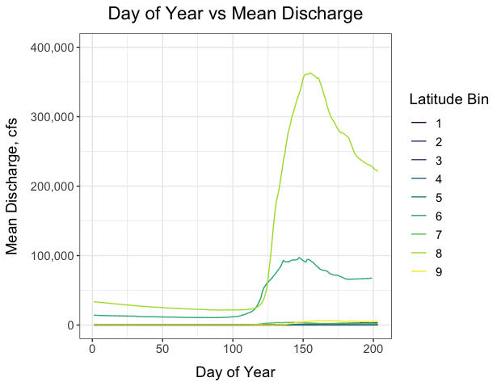
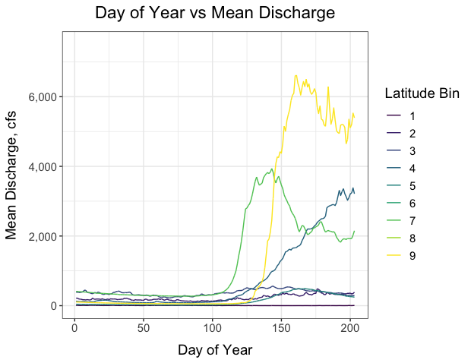
Exploratory Analysis: Day of Year of Snowmelt

Slide 11
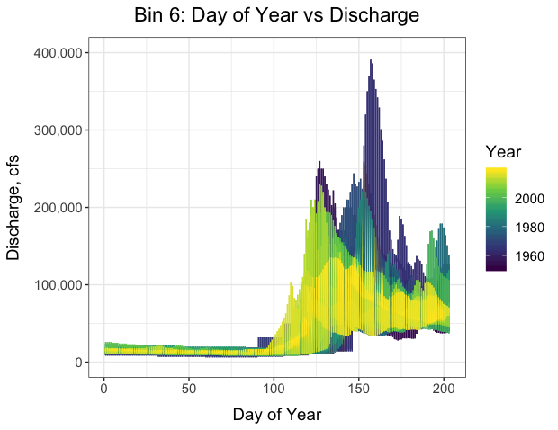
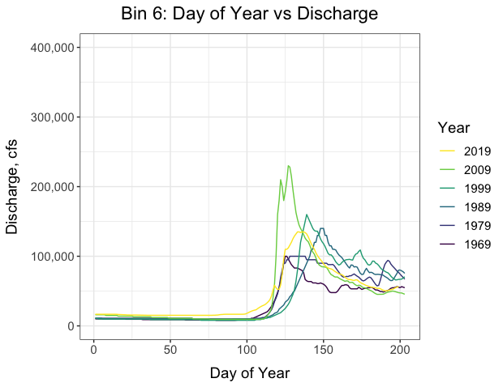
Exploratory Analysis: Day of Year of Snowmelt

Slide 12
Latitude Bin 5
NOAA Sites-Precipitation and Temperature
NWIS Sites-Discharge

Slide 13
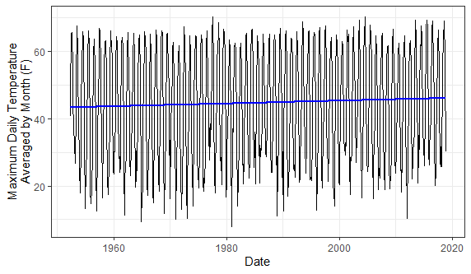
Analysis: Temperature
Seasonal Mann Kendall to determine if significant change and seasonality of change
Sen's Slope to determine magnitude of trend
Notes:
Seasonal Mann Kendall on Temperature, Sens slope on significant latitude bins
Weak evidence from our 9 sites of polar amplification

Slide 14
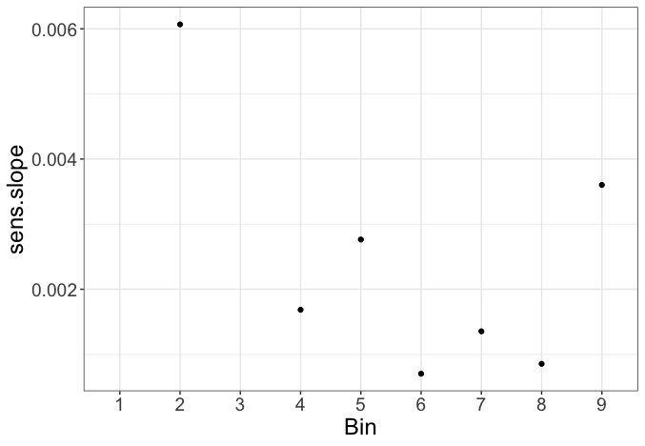
Analysis: Discharge
Notes:
Season mann kendall test. Relationship between Sens.slope of normalized discharge and bin. Except for bin 1 and 3, discharge of other bins have seasonal change, though it seems like it is a tiny change. And they are all positive which indicates that discharge is slightly increasing over time.

Slide 15
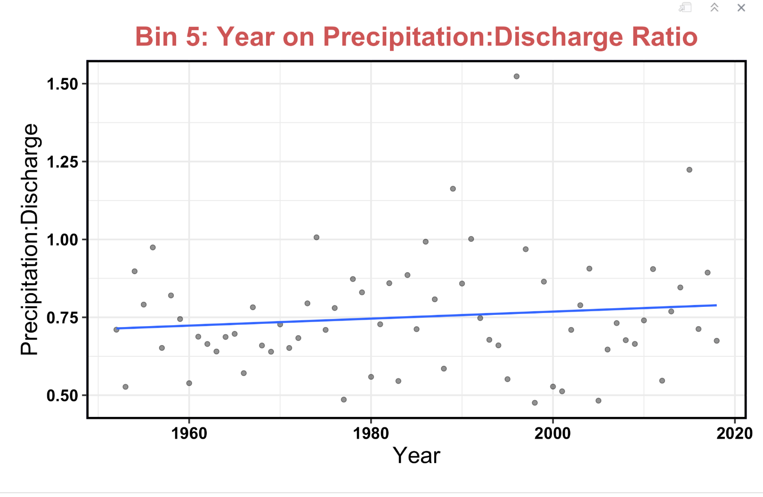
Analysis: Precipitation

Slide 16
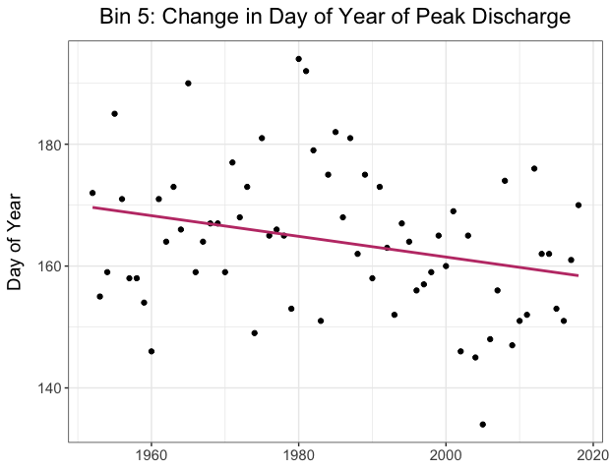
Analysis: Day of Year of Snowmelt
Used changes in peak discharge as a proxy for snowmelt
Computed peak discharge for each year and ran linear model to see whether the day of year of peak discharge is changing over time
Notes:
0.17

Slide 17
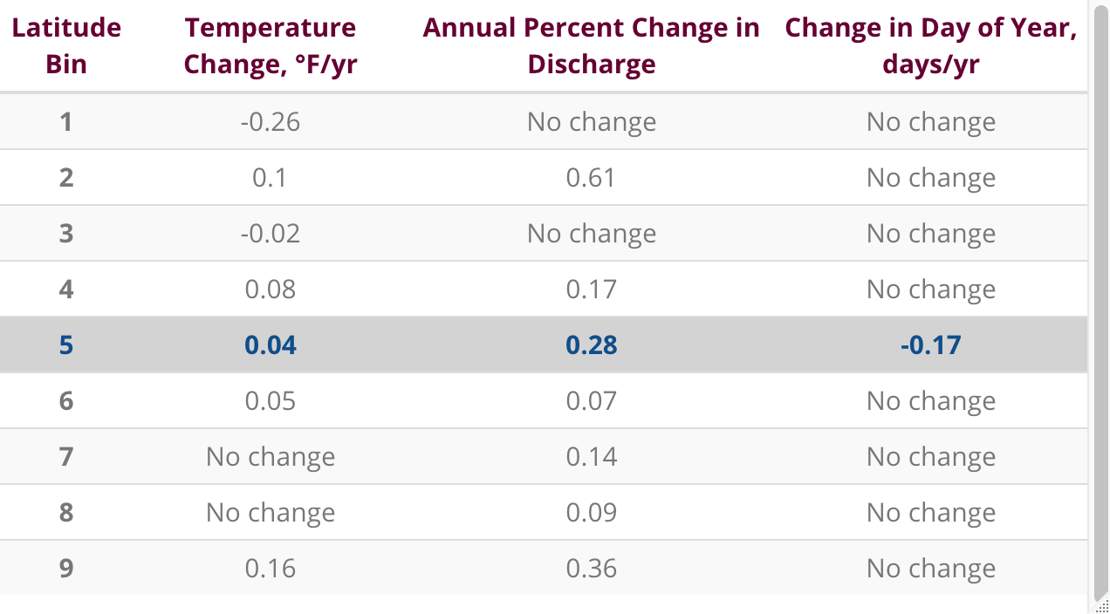
Summary
Bin 5 was the only latitude bin that showed significant changes in temperature, discharge, and day of year of peak discharge.

Slide 18
Conclusions
Hypotheses:
Streams at varying latitudes will have different responses to changing climate with a monotonic trend related to latitude. NOT PROVEN
If streams are in areas that experience greater mean air temperature increases, then they will have greater discharge. NOT PROVEN
If temperature increases over time, the day of year of first snowmelt will occur earlier. NOT PROVEN

Slide 19
Citations
Serreze, M. C., Barrett, A. P., Stroeve, J. C., Kindig, D. N., and Holland, M. M.: The emergence of surface-based Arctic amplification, The Cryosphere, 3, 11–19, https://doi.org/10.5194/tc-3-11-2009, 2009.
Earth System Research Laboratory. Barrow's Annual Snow Cycle; Ecological Responses to a Lengthening Snow-free Season. (2017.). Retrieved from https://www.esrl.noaa.gov/gmd/grad/snomelt.html.
U.S. Geologic Survey. Snowmelt Runoff and the Water Cycle. Retrieved from https://www.usgs.gov/special-topic/water-science-school/science/snowmelt-runoff-and-water-cycle?qt-science_center_objects=0#qt-science_center_objects.
Kashiwase, H., Ohshima, K. I., Nihashi, S., & Eicken, H. (2017). Evidence for ice-ocean albedo feedback in the Arctic Ocean shifting to a seasonal ice zone. Scientific reports, 7(1), 8170.

